Slide 1
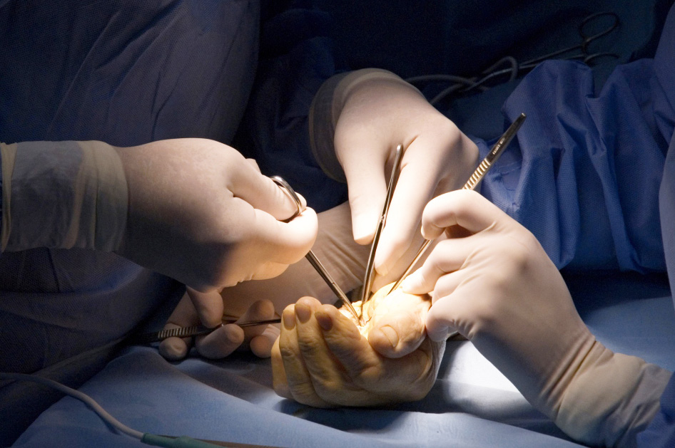

Global Hand Teaching Programme
The Reconstructive Ladder

Slide 2
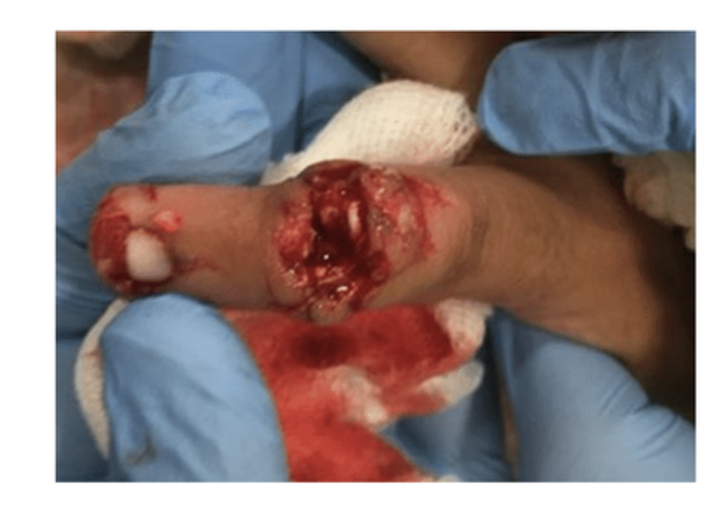

Case 1
42 year old man who got his left little and ring finger tips caught in a lawnmower. Fingertip injuries as shown. Little finger has exposed distal phalanx, ring finger does not.
What do you want to know in your history when considering your reconstructive options?
What are your options for soft tissue coverage of these defects?
Could either of these digits be managed conservatively?
Generally are skin grafts a useful way of reconstructing fingertips?
bssh.ac.uk

Slide 3
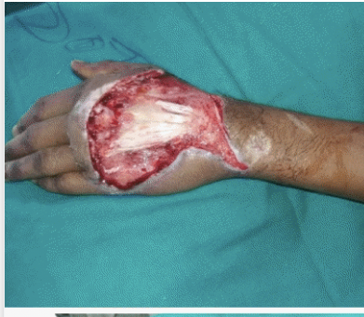
Case 2
65 year old man who had a necrotic wound debrided from dorsal of left hand is left with this wound.
Why is it important to assess for paratenon presence?
What device could be used during the interim period of debridement and reconstruction?
If there is no paratenon what are your reconstructive options?
Why is a fasciocutaneous free flap generally preferred to a muscle flap in dorsal hand coverage?
Reverse Posterior Interosseous Artery Flap: A Reliable, Comfortable and Versatile Flap for Coverage of Soft Tissue Defects of Hand
Mohammed Fahud Khurram, Sudheer Kumar Maurya, Mohd Yaseen, Madhav Chowdhry
bssh.ac.uk

Slide 4
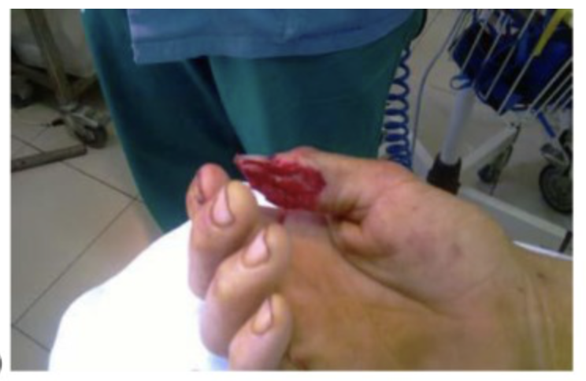
Case 3
25 year old right handed man with this thumb injury.
Describe the defect seen.
What are your reconstructive options?
What artery is the Foucher flap based upon?
Kola N. Thumb Reconstruction Using Foucher's Flap. Open Access Maced J Med Sci. 2016
bssh.ac.uk

Slide 5
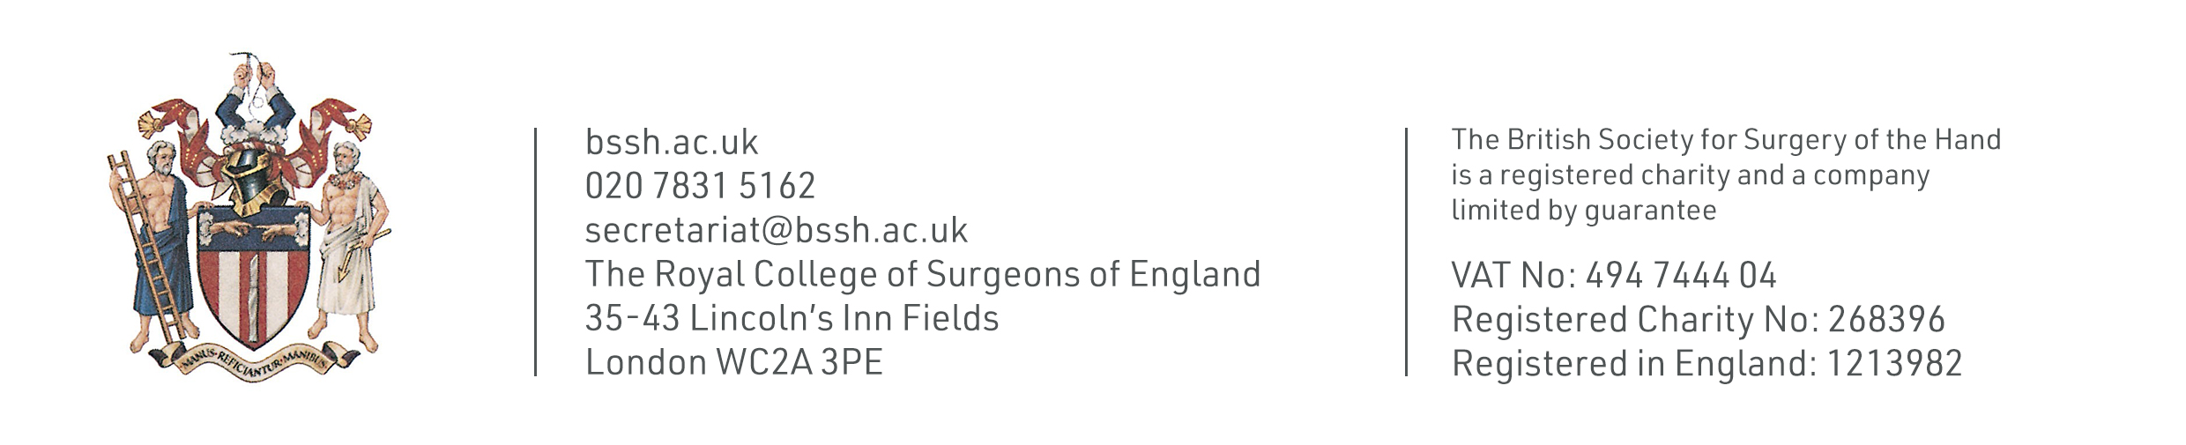
For further information please
get in touch via the channels below:

