Slide 1
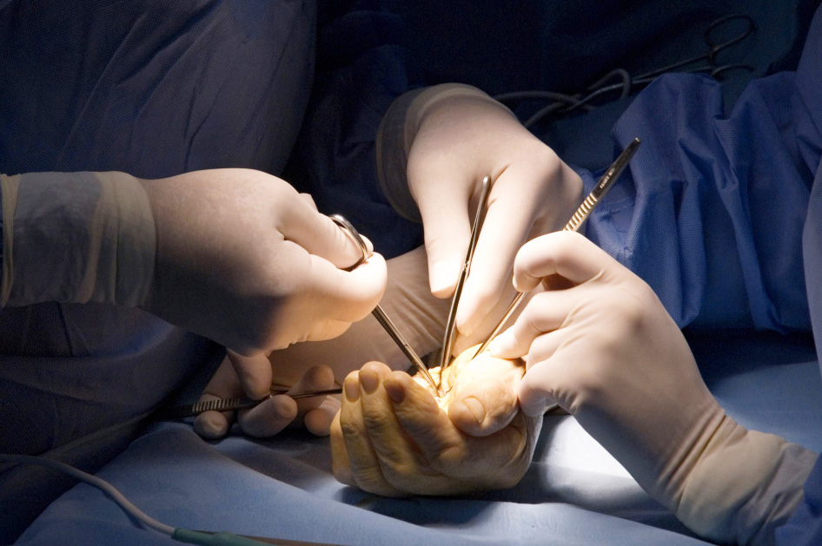
Wound Healing and Complications
Objectives
Understand the principles of wound healing
2. Utilise the principles when considering surgical management of cases

