Slide 1

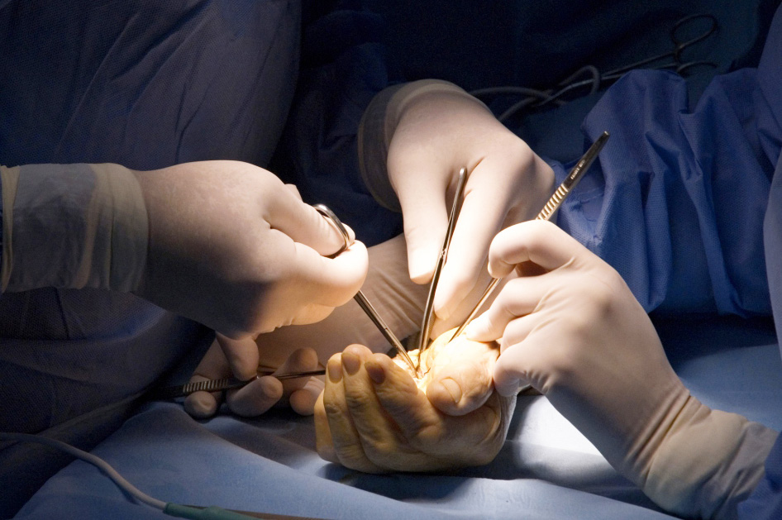
The Reconstructive Ladder
Objectives
Understand the principles of the reconstructive ladder
2. Utilise the principles when considering options for wound coverage
3. Consider the term ‘Reconstructive elevator’ rather than ‘ladder’

