Slide 1

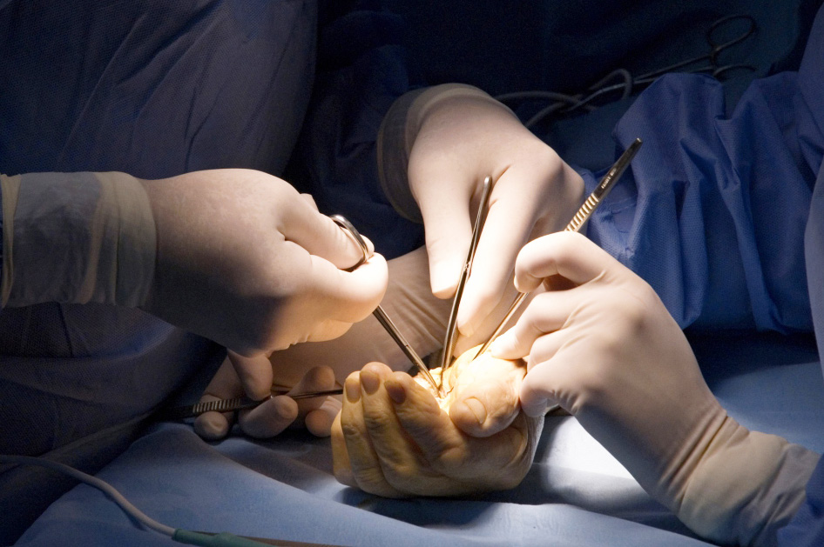
Module 4.10 Vasospastic disorders
Objectives
Understanding the changes in the macro- and micro circulation in relation to the vascular anatomy of the hand in patients with vasospastic disorders
Discuss the role of diagnostic tests in vasospastic disorders and how it differs between stenotic and occlusive disease
Understanding of medical and surgical management options for patients with vasospastic disorders
Awareness of conditions that can lead to vasospastic disorders

