Slide 1
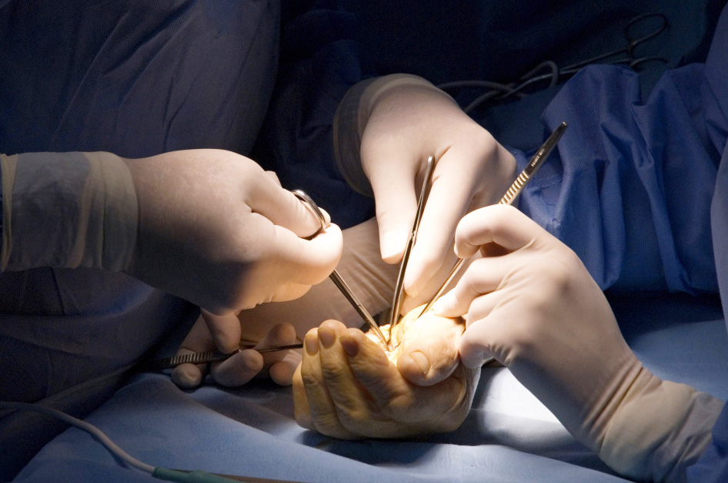
Module 4.12 Injection injuries
Objectives
To understand the diagnosis and management of high pressure injection injuries
To discuss the various aspects of high pressure injection injuries – pressure, toxicity, volume, secondary infection
To understand that high pressure injection injuries can lead to loss of limb or life

