Slide 1
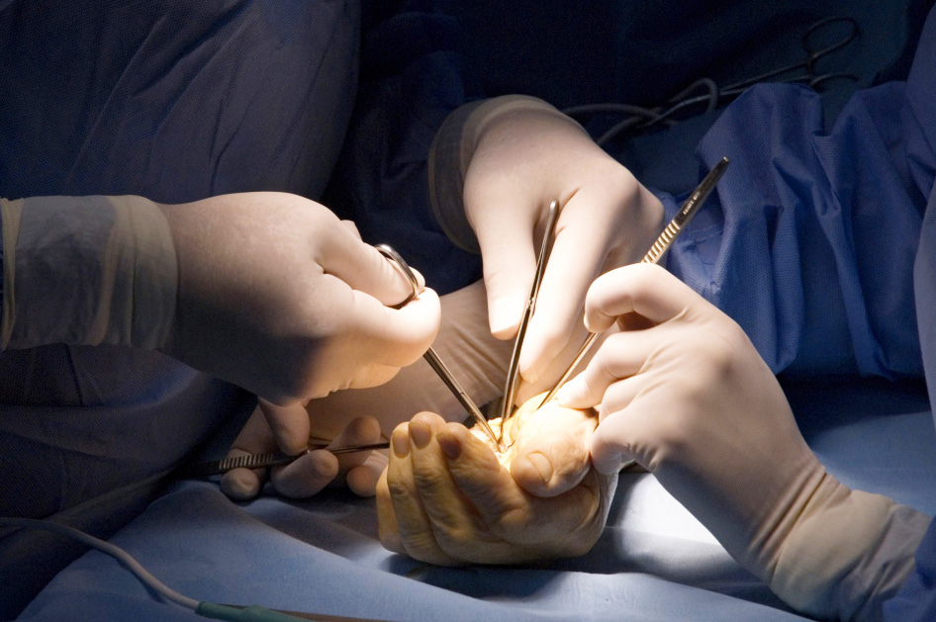
Module 4.8 MDT management of tumours
Objectives
Understanding of the TNM classification system for tumours
Discussion of the reconstructive options following tumour resection
Discussion of the role of the multi-disciplinary team in the holistic care for patients with upper limb tumours

