Slide 1
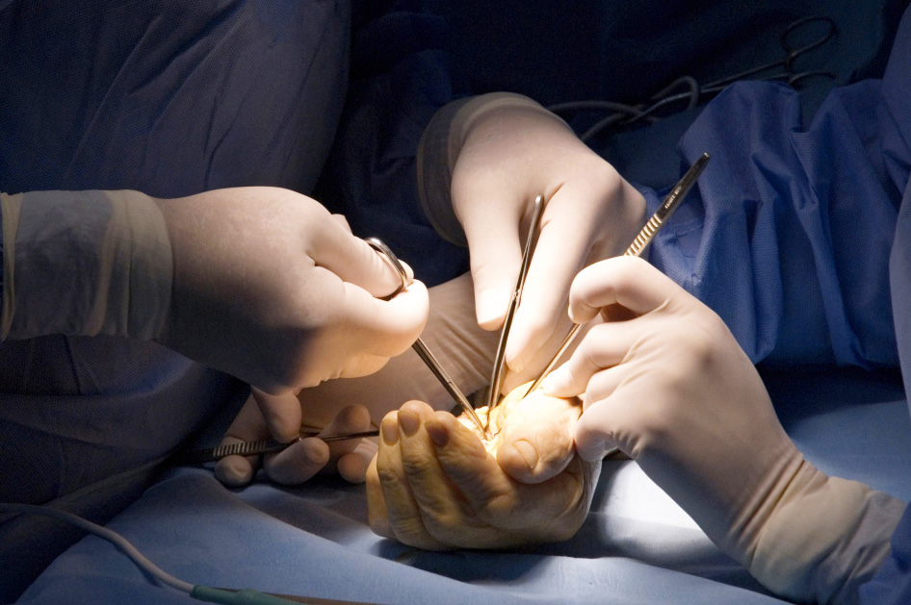
Global Hand Teaching Programme
Extravasation Injuries

Slide 2
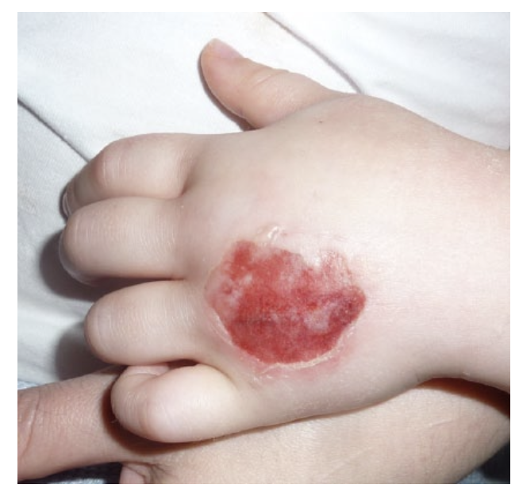
Case 1
3 year old child had IV contrast extravasate while having MRI scan.
What is your definition of an extravasation injury ?
What are the risk factors for extravasation injuries?
What would your initial management plan be for the referring team?
What would your management plan be on arrival and seeing the patient?
I. Goutos, L. K. Cogswell and H. Giele Extravasation injuries: a review. Journal of Hand Surgery 2014. Vol. 39E(8) 808–818
bssh.ac.uk

Slide 3
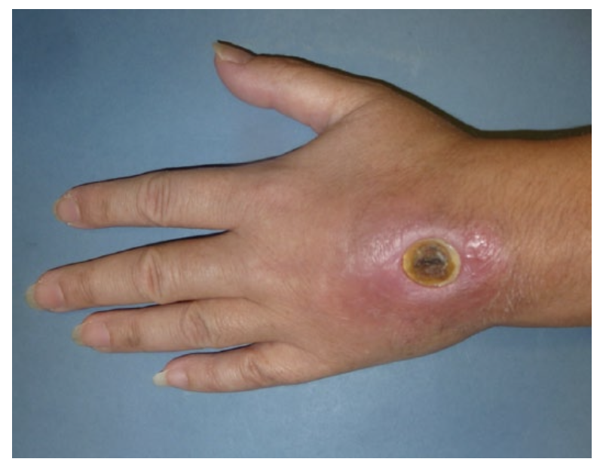
Case 2
A vesicant DNA binding chemotherapeutic agent extravasated 4hrs ago and resulted in the below injury.
What are your management options?
I. Goutos, L. K. Cogswell and H. Giele Extravasation injuries: a review. Journal of Hand Surgery 2014. Vol. 39E(8) 808–818
bssh.ac.uk

Slide 4
For further information please
get in touch via the channels below:

