Slide 1
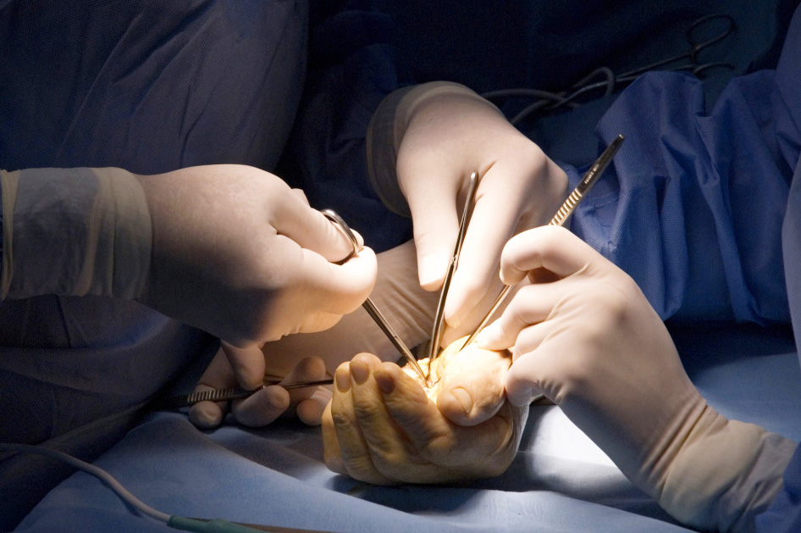
Extravasation Injuries
Objectives
Recognise signs of extravasation injuries
Understand the properties of agents to be aware of when considering prognosis of injury
Recognise the early management of extravasation injuries

