Slide 1
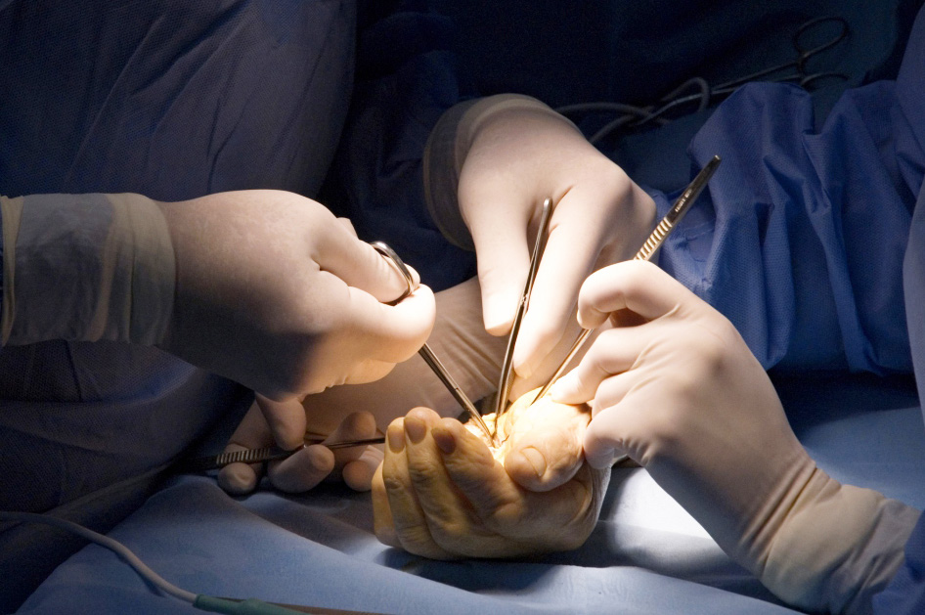

Necrotising Fasciitis
Objectives
Recognise signs of necrotising fasciitis, its staging and management

