Slide 1
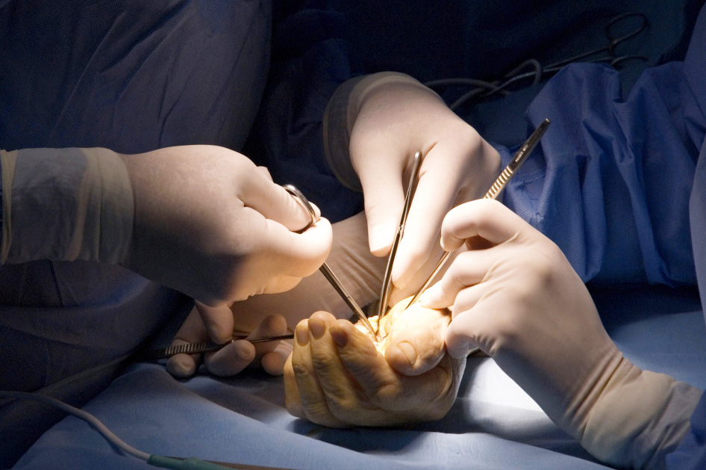
Thumb Arthritis inc. CMCJ
Objectives
Recognise the signs and symptoms of arthritis of the base of the thumb, relevant investigations and treatment options

