Slide 1
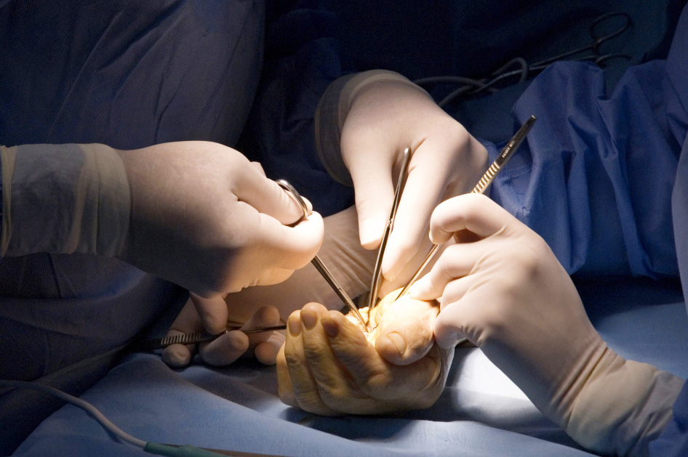
Global Hand Teaching Programme
Scapho-lunate ligament injuries

Slide 2
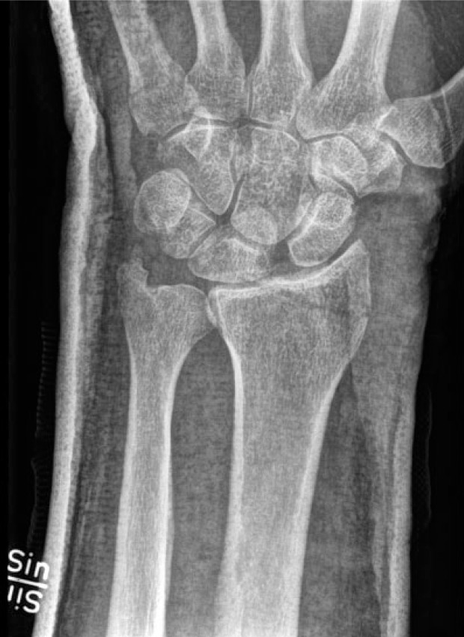
Case 1
This 30 year old man had a fall while playing football. He presents two weeks after injury with pain and swelling to the dorsal of the wrist with limited extension of the wrist.
Describe the XR findings
What is the eponymous name for the fracture shown?
Do you know any clinical examination tests to assess scaphoid stability?
What is the next investigation you would order?
Andersson JK. Treatment of scapholunate ligament injury: Current concepts. EFORT Open Rev. 2017 Sep 19;2(9):382-393. doi: 10.1302/2058-5241.2.170016. PMID: 29071123; PMCID: PMC5644424.
bssh.ac.uk

Slide 3
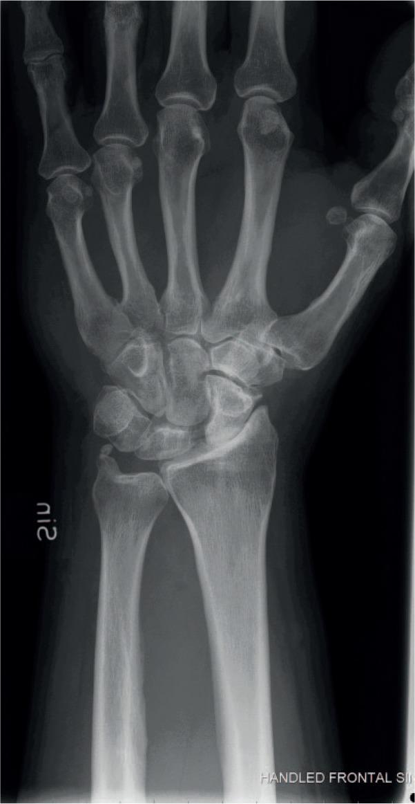
Case 1
What are the findings of the XR?
What do you understand by the terms DISI and VISI and SLAC?
Do you know any grading systems used for scapho-ligament injuries?
What treatment options are available?
Andersson JK. Treatment of scapholunate ligament injury: Current concepts. EFORT Open Rev. 2017 Sep 19;2(9):382-393. doi: 10.1302/2058-5241.2.170016. PMID: 29071123; PMCID: PMC5644424.
bssh.ac.uk

Slide 4
For further information please
get in touch via the channels below:

