Slide 1
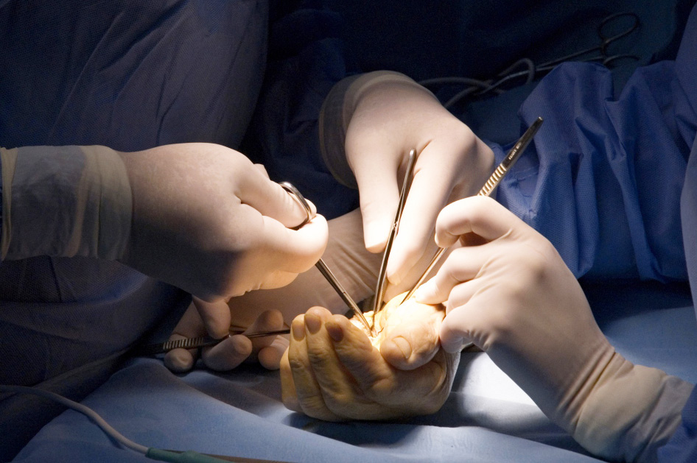
Scapho-lunate ligament injuries
Objectives
To understand the importance of identifying such injuries, the timeline of disease progression and management options

