Slide 1
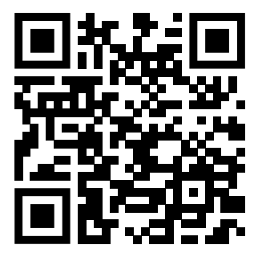
Teaching feedback link M6.13
https://s.surveyplanet.com/2k3ubnpt

