Slide 1

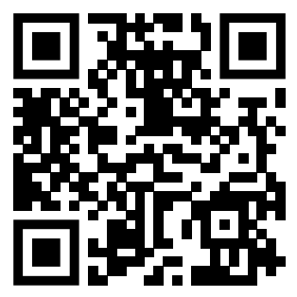
Teaching feedback link M6.14
https://s.surveyplanet.com/thfzh3lq

