Slide 1

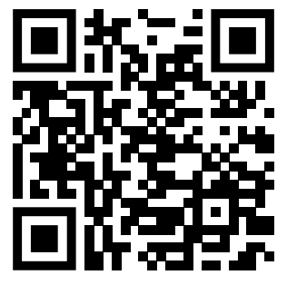
Teaching feedback link M6.15
https://s.surveyplanet.com/2ssqvqz3

