Slide 1
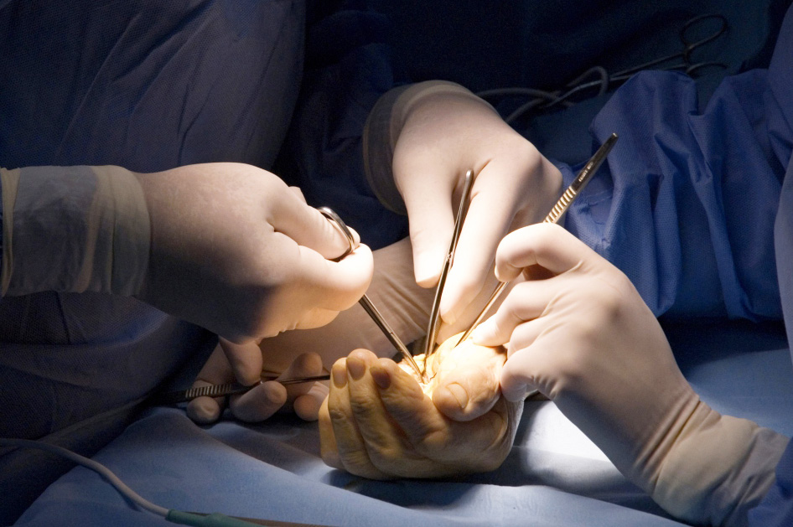

Management of elbow and axillary contractures
Objectives
To recognise the importance of early burns management in preventing elbow and axillary contractures. Once established to recognise the surgical step wise approach to restoring function.

