Slide 1
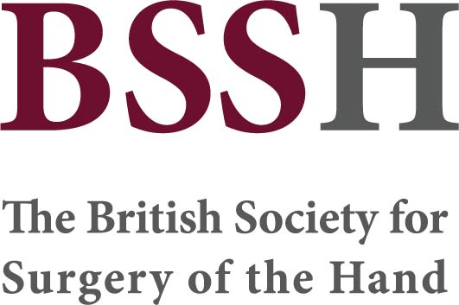
Module 7.1 The acutely burned hand
Objectives
To understand the principles of assessment and management of burn injuries in the acute phase
To understand the anatomical characteristics of the hand in relation to burn injuries
To understand the intended functional and aesthetic outcomes following burn injuries to the hand
To understand the role of MDT in management of patients with burns to the hand

