Slide 1
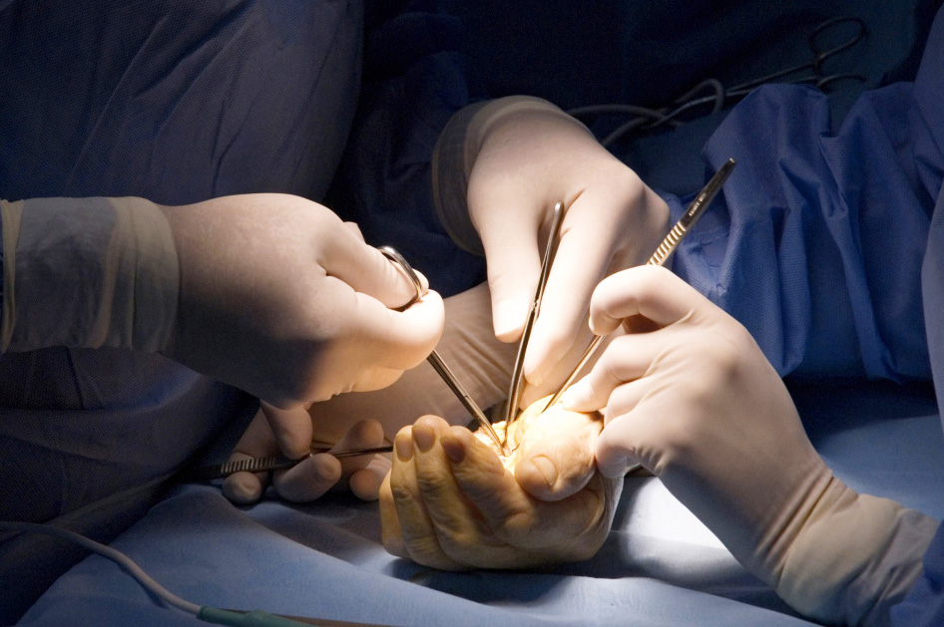
Global Hand Teaching Programme
Embryology of the hand

Slide 2
Case 1
At what time point during fetal development does the limb start to develop?
Failure of limb induction is known as what?
What is the role of the Apical Ectodermal Ridge?
What is the role of the Zone of Polarising Activity?
What is the role of the dorsal ectoderm?
Where is Sonic Hedgehog (SHH) secreted from?
bssh.ac.uk

Slide 3
For further information please
get in touch via the channels below:

