Slide 1
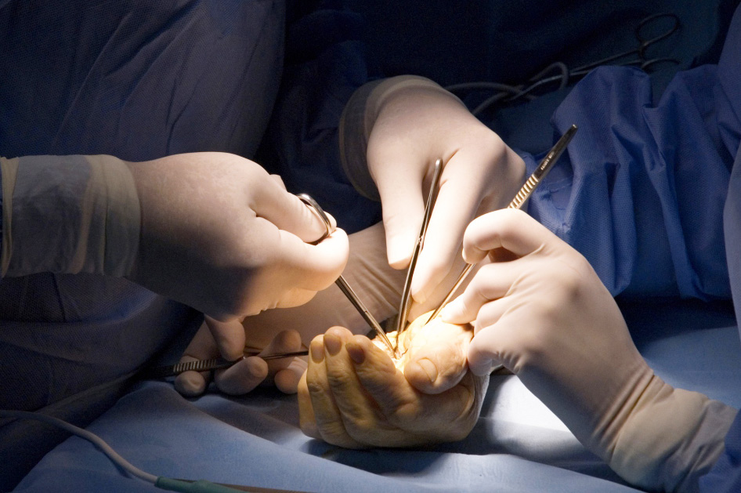
Syndactyly
Objectives
To describe the epidemiology and pathogenesis
To understand the classification
To recognise the surgical approaches

