Slide 1
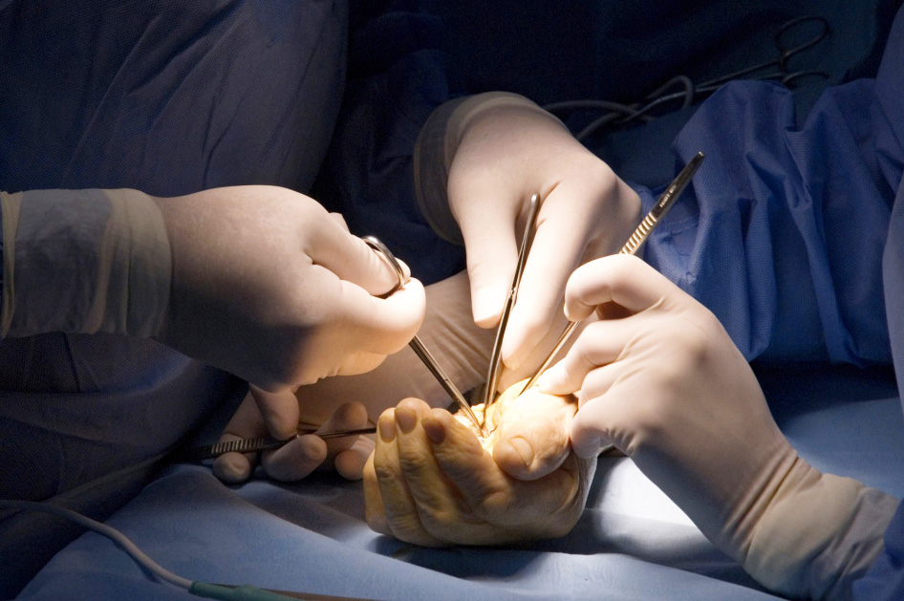
Tendon Workshop

Slide 2
Session Objectives
To be able to perform the following suture techniques on a goat tendon model;
4 strand core cruciate
Running epitendon
silfverskiold epitendon
bssh.ac.uk

Slide 3
Faculty Information
Requirements -
Drinking straws to facilitate demonstration of technique
Goat tendons
Fridge for storage
Pre-session dissection of goat tendons
Trays for goat tendons to be placed for session
Tables
Gloves and aprons
A bright spacious room
Sutures (prolene/ethibond), needle holder, scissors
Sharps bins
bssh.ac.uk

Slide 4
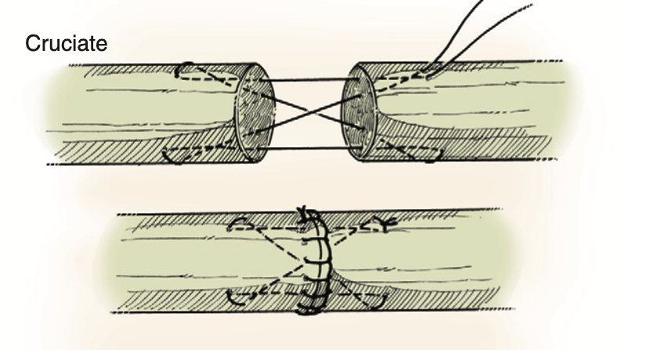
4 strand core cruciate technique
Green’s operative hand surgery, 6th ed. Wolfe et al.
bssh.ac.uk

Slide 5
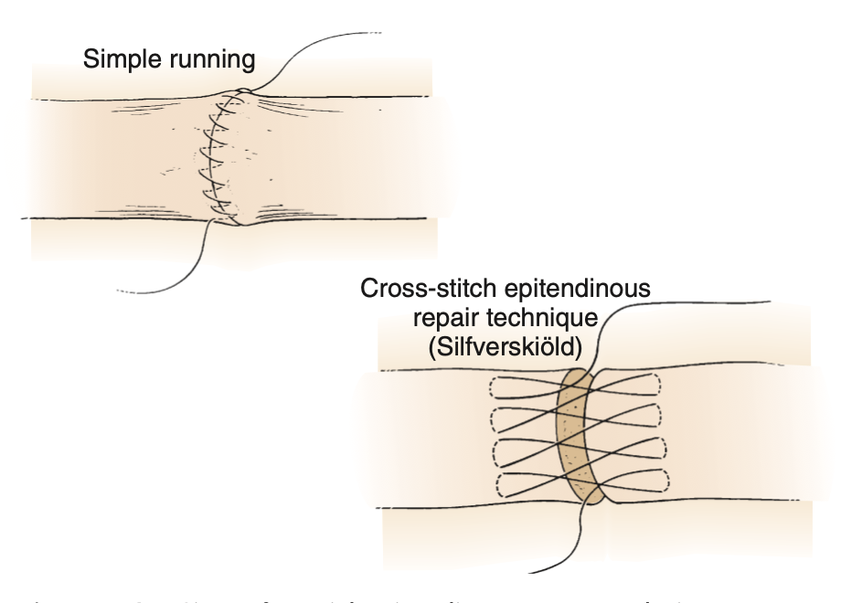
Epitendon technique
Green’s operative hand surgery, 6th ed. Wolfe et al.
bssh.ac.uk

Slide 6
For further information please
get in touch via the channels below:

