Slide 1
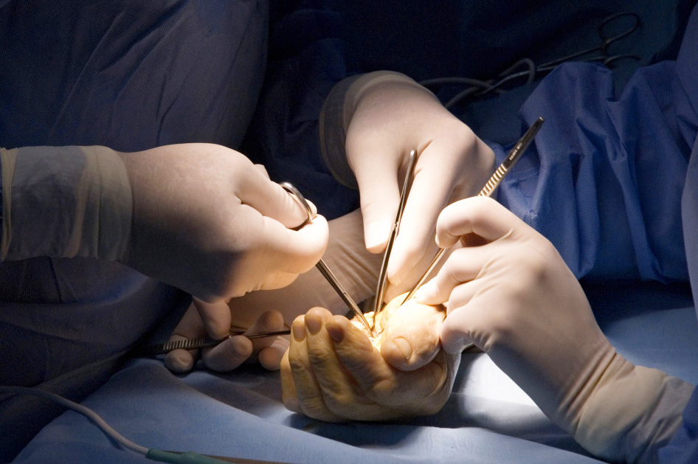
Wound debridement workshop

Slide 2
Session Objectives
To understand and act on the principles of sound wound debridement
bssh.ac.uk

Slide 3
Faculty Information
Requirements -
Chicken leg
Soil/stones
Fridge for storage
Pre-session preparation of chicken leg to ensure soiled in different planes
Trays for chicken to be placed for session
Tables
Gloves and aprons
A bright spacious room
Scalpel, tenotomy scissors
Saline/water wash
Swabs
Sharps bins
Waste bins
bssh.ac.uk

Slide 4
For further information please
get in touch via the channels below:

